Slide 1

PRE-DEPARTURE BRIEFING – KYUSHU
Mike Tan
SA Tours

Slide 2
FLIGHT DETAILS:
Departure and Transit:
-15 June 2014, Sunday
-Meet at 8pm, Changi Airport Terminal 2, Row 6
-KE644 SINICN 2235/0555+1
-KE787 ICNFUK 0800/0920
Arrival and Transit:
-21 June 2014, Saturday
-KE788 FUKICN 1030/1155
-KE643 ICNSIN 1420/1930
Transit at Incheon Airport for 1h 15 mins
Transit at Incheon Airport for 1h 15 mins

Slide 3
FLIGHT LOGISTICS:
KE will serve dinner 2 hours after takeoff
Flight is 6 hours 20 minutes
Keep your boarding pass and passports after check-in in your bags. You are likely to lose them if you hold them on your hands.
Seats are assigned by airline. If you want to exchange seats, do so after everyone has settled down.
For those with dietary restrictions, meals are given by seat number, so do not move away.
Those who can’t eat beef: meals are replaced with seafood

Slide 4
FLIGHT LOGISTICS:
Each person is allowed to bring max 2 pieces of luggage
-1 for check-in (Max 20kg) and 1 for hand-carry (55cm X 40cm X20cm)
To assist logistics in getting everybody’s luggage after arrival, all luggage will be tagged for easy retrieval.
IMPORTANT:
-Night cream, lotions, contact lens solution, toiletries, hairspray, hair gel etc must all be kept in check-in luggage
-You can bring medicine, eye drops or contact lens solution (if required) on board, but all liquids must be in max 100ml bottles and in transparent zip lock bags.
-Try not to wear contacts and bring an extra pair of glasses

Slide 5
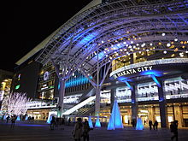
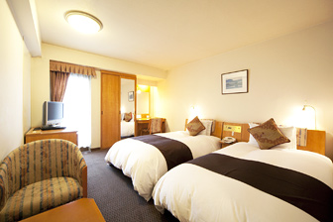
ACCOMODATION DETAILS
Hakata Miyako Hotel (16, 19, 20 June)
1 minute away from JR Line Hakata Station (Shinkasen) and Hakata City located in the station
All guest rooms have free Wi-Fi and wired internet access
Free Wi-Fi is also available in lobby (level 2)

Slide 6
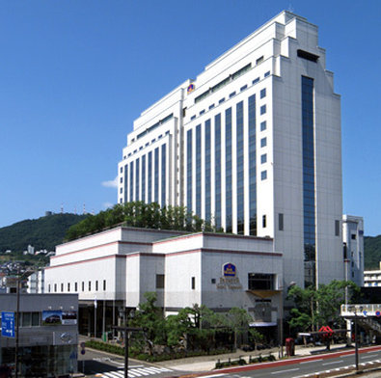
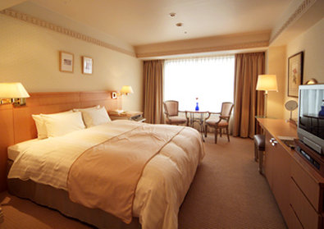
ACCOMODATION DETAILS
Best Western Premier Hotel Nagasaki (17 June)
5 minutes walk from JR Nagasaki Station
Wi-Fi present in both the guest rooms and hotel lobby

Slide 7
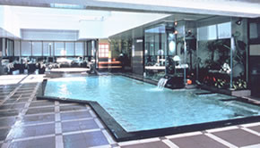
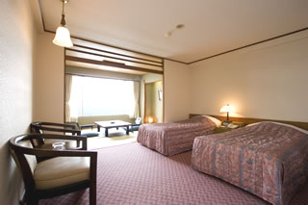
ACCOMODATION DETAILS
Beppu Seifu Hotel (18 June)
10 minutes walk from JR Beppu Station
3 different Hot Spring Baths, Open-Air Baths and Sauna (No bathing suits allowed in onsens)
Free Wi-Fi in Lobby

Slide 8
WEATHER
26°C to 31°C
Advised to wear normal casual clothes: T-shirts, jeans etc
Please bring a light jacket and a foldable umbrella /disposable raincoat since it is forecasted to have heavy rain
Wear a pair of comfortable walking shoes
Avoid wearing sandals when visiting tourist areas

Slide 9
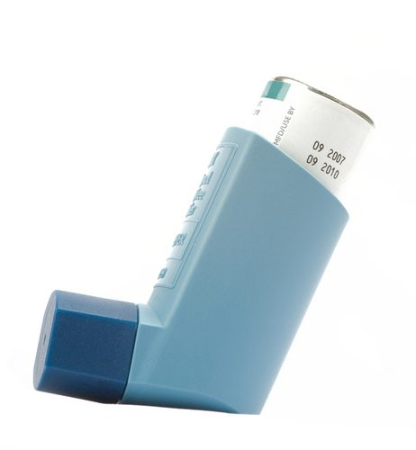
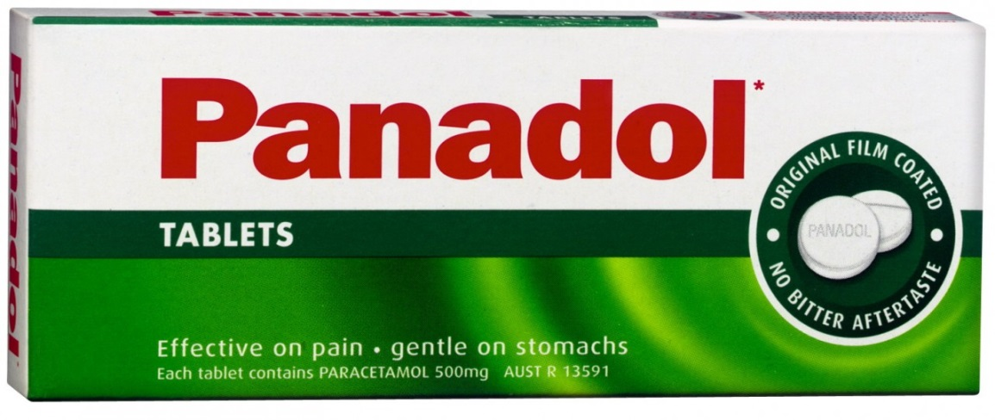
MEDICATION
Bring any necessary medication that you need: aspirin, Panadol, allergy medication, nausea medication etc
If you have asthma, bring a full inhaler in your hand carry bag

Slide 10
INSURANCE
Each student is insured with Chartis (from Great Eastern)
Claims can be made for illnesses, injuries, baggage delay, repatriation and personal liabilities abroad

Slide 11
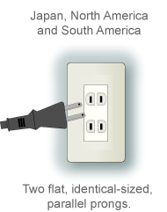
ELECTRONICS:
Bring adaptors for appliances that require charging
Try not to bring expensive cameras and phones
Switch off your data plan to prevent extra cost being incurred
Data roaming is only for phones with 3G

Slide 12
EXTRA INFORMATION:
Time in Japan is 1 hour ahead of Singapore
-eg: 1400h in Japan is 1300h in Singapore
Currency (Yen)
-Exchange rate in late May 2014
100 Yen to 1.23 SGD
All meals, transport and accommodation is provided
If you intend to spend in Incheon Airport, feel free to change some money to Korean Won (1000 Won to 1.20 SGD)

Slide 13
EXTRA INFORMATION:
Fukuoka is 1,020km southwest of Fukushima where the damaged nuclear power plant is located.
The mid-latitude Westerlies wind this year is highly unlikely that air-borne radiation leaked from reactors will reach Fukuoka at Health-threatening levels.
Vegetables and Dairy Products distributed in Fukuoka are locally grown in Kyushu region.

Slide 14
INFORMATION FOR CALLS MADE
Calls from Singapore to Japan
-Starhub: 018+81XXXXXXXX
-Singtel: 019+81XXXXXXXX
-M1: 021+81XXXXXXXX
Calls from Japan to Singapore
-Call as per normal, but the caller and received party must both have +65 prefix added to the phone numbers (for 3G phones and roaming service needs to be activated)

Slide 15
INFORMATION FOR CALLS MADE
Calls from Japan to Singapore/Other countries
-For global roam services for Starhub:
Calling Singapore: *108*65<Number>#
Calling other countries: *108*<Country code><Area code><Number>#
-For global roam services for M1:
Calling Singapore: *138*65<Number>#
Calling other countries: *138*<Country code><Area code><Number>#
-For global roam services for Singtel:
Calling Singapore: *121*65<Number>#
Calling other countries: *121*<Country code><Area code><Number>#

Slide 16
CONTACT INFORMATION
Sino-America Tours Corporation (SA Tours)
-1, Park Road, #04-62, Singapore 059108
-Ms Bee Ann: Operations Manager, +65 6501 3862
-Ms Doris: Operations Executive, +65 6501 3958
Singapore Ministry of Foreign Affairs (MFA)
-Call Centre: 1800 476 8870
-Main: +6379 8000
-Duty Office: +65 6379 8855

Slide 17
PRE-DEPARTURE BRIEFING – KYUSHU
Valerie Goh

Slide 18
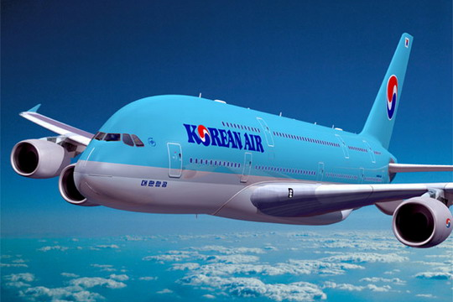
ITINERARY DAY 0: 15 JUNE
Overnight flight and transit at Incheon Airport, before arriving at Fukuoka
Assemble at Changi Airport at 8pm
Expected arrival time in Fukuoka Airport: 9.20am

Slide 19
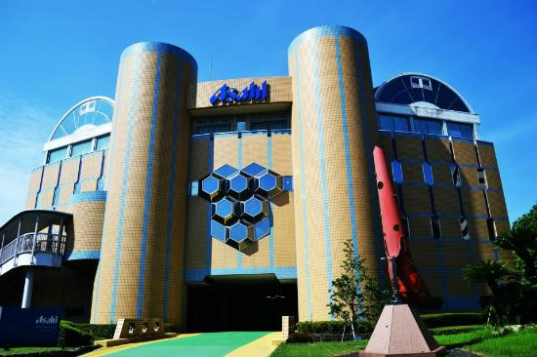
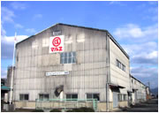


ITINERARY DAY 1: 16 JUNE
Asahi Beer Factory
Kewpie Mayonnaise Factory
Soy Sauce Factory (Marue Shoyu)
Notes:
http://yokanavi.com/eg/landmark/index/394
http://www.tripadvisor.com.sg/Attraction_Review-g298207-d1742643-Reviews-Asahi_Brewery_Hakata-Fukuoka_Fukuoka_Prefecture_Kyushu_Okinawa.html

Slide 20
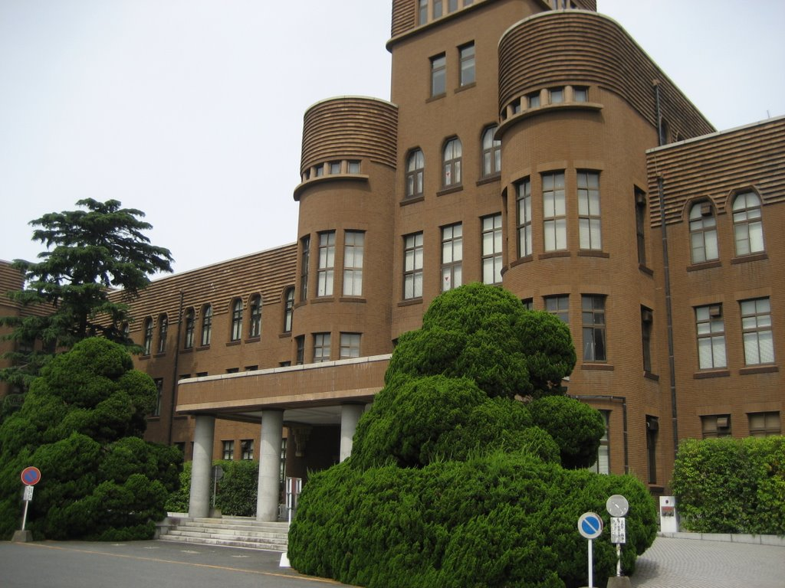
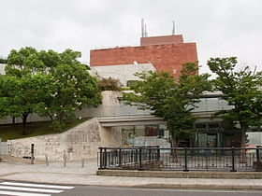
ITINERARY DAY 2: 17 JUNE
Visit to Kyushu University
Vinegar Factory Visit
Atomic Bomb Museum and Peace Park

Slide 21
KYUSHU UNIVERSITY VISIT
TIME
9:00 Meeting point at Center 1 building
9:20-10:10 Introduction of KU and 21st Century Program
10:20-11:10 Introduction of NTU and CN Yang Scholars Programme
11:00-12:00 Phototaking and Lunch
12:00-12:40 Mingling session (Quiz Game about Japanese Culture)

Slide 22
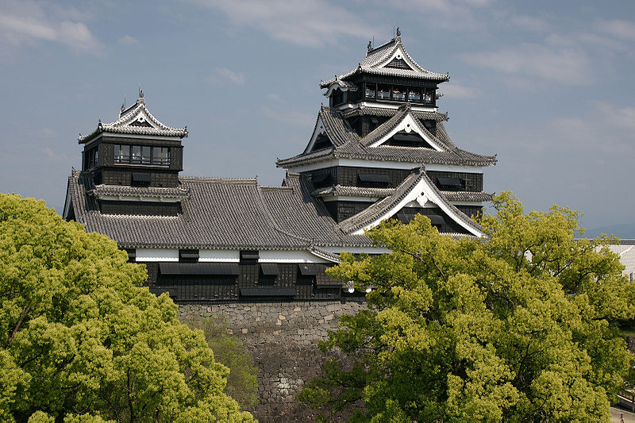
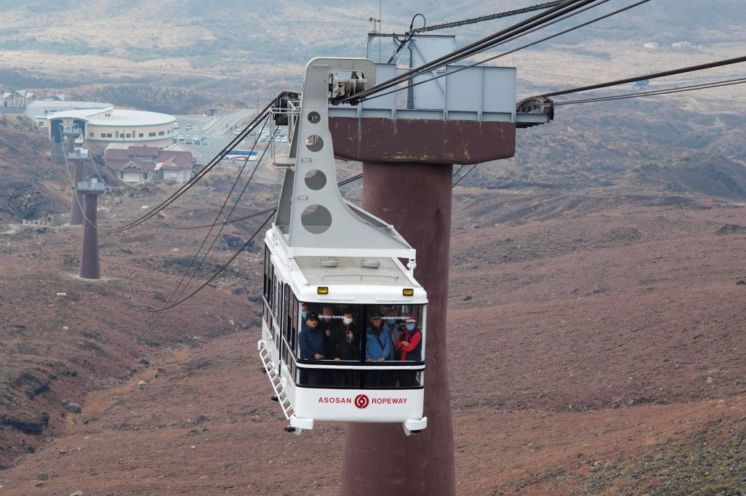
ITINERARY DAY 3: 18 JUNE
Kumamoto Castle
Mount Aso Ropeway
Notes:
Mount Aso Ropeway: first passenger lift to carry people to an active volcano

Slide 23
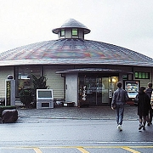
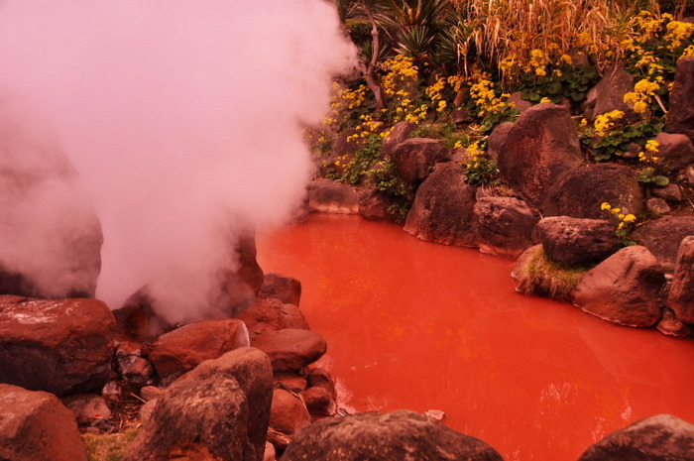
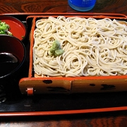
ITINERARY DAY 3: 18 JUNE
Soba Making
Chinoike Jigoku Hot Spring

Slide 24
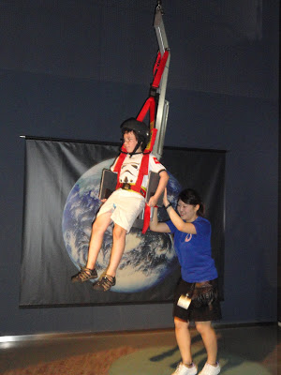
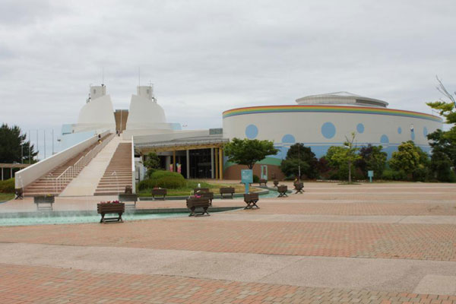
ITINERARY DAY 4: 19 JUNE
AIST:
Space and Science Museum
Advanced Industrial Science & Technology
Genkai Energy Park
Notes:
Space and Science museum to learn about the Universe, Earth and the relationship between them. Many interactive exhibits
Genkai Energy park: facility where visitors can come in contact with various forms of energy, with a focus on nuclear energy. Presence of a model nuclear reactor

Slide 25
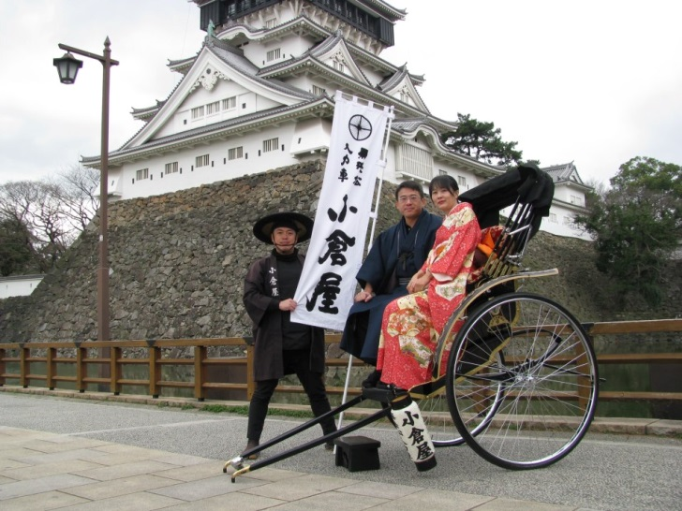
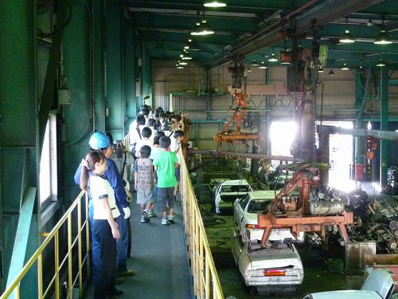
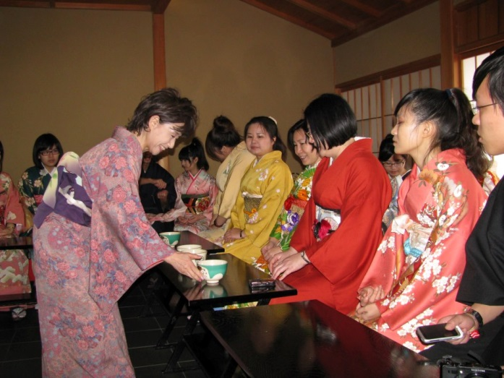
ITINERARY DAY 5: 20 JUNE
Tea Cultural Ceremony at Kokura Castle
Eco Town
Notes:
http://www.japanfs.org/en/news/archives/news_id031001.html

Slide 26
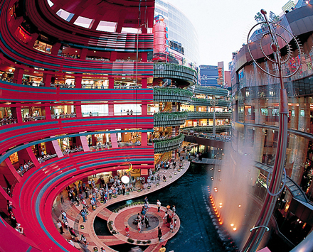
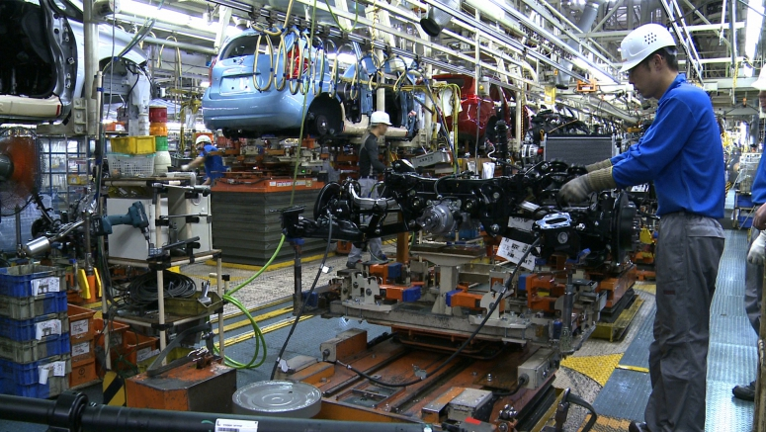
ITINERARY DAY 5: 20 JUNE
Nissan Car Factory Visit
Canal City
Notes:
http://www.japanfs.org/en/news/archives/news_id031001.html

Slide 27
ITINERARY DAY 6: 21 JUNE
Transfer to airport for departure
Estimated time of arrival in Singapore: 1930h

Slide 28
GROUPING LIST:
A: Koon Siang, Jedi, Samuel, Timothy, Man Ting, Han Lyn, Diego, Marcus, Huiling, Jiaxing, Ferdian, Podianko
B: Valerie, Jie Ling, Ka Wai, Qi Hui, Gary, Xiao Tong, Wang Tong
C: Zenn, Qin Hui, Hui Qin, Deborah, Enya, Lim Min, Kashmira, Smrithi
D: Kelvin, Qi Lin, Lionel, Khoan, Hijanah, Mengke, Ba Loc, Junru

Slide 29
ACCOMODATION LOGISTICS
Rooms are requested to be in the same level
Passports will be collected and stored in hotel safe (if you want)
Team leaders will receive the keys to distribute to team members
Team leaders are responsible for their team members
-Make sure they wake up and report on time
Don’t make a lot of noise in the rooms and corridors
CURFEW: 11pm!

Slide 30
BEHAVIOUR MATTERS
Listen to instructions from the team leaders, tour guide and tour manager
Be punctual for all events: make sure to wake up on time and report back to the bus on time
Be responsible and take care of your belongings and of each other

Slide 31
ANY QUESTIONS?

